Slide 1
1 Timothy 6 (Part C) v17-21
(English Standard Version)

Slide 2
6 Let all who are under a yoke as bondservants regard their own masters as worthy of all honour, so that the name of God and the teaching may not be reviled. ² Those who have believing masters must not be disrespectful on the ground that they are brothers; rather they must serve all the better since those who benefit by their good service are believers and beloved.

Slide 3
Teach and urge these things. ³ If anyone teaches a different doctrine and does not agree with the sound words of our Lord Jesus Christ and the teaching that accords with godliness, ⁴ he is puffed up with conceit and understands nothing. He has an unhealthy craving for controversy and for quarrels about words, which produce envy, dissension, slander, evil suspicions, ⁵ and constant friction among people who are depraved in mind and deprived of the truth, imagining that godliness is a means of gain. ⁶ But godliness with contentment is great gain, ⁷ for we brought nothing into the world, and we cannot take anything out of the world.

Slide 4
⁸ But if we have food and clothing, with these we will be content. ⁹ But those who desire to be rich fall into temptation, into a snare, into many senseless and harmful desires that plunge people into ruin and destruction. ¹⁰ For the love of money is a root of all kinds of evils. It is through this craving that some have wandered away from the faith and pierced themselves with many pangs.
¹¹ But as for you, O man of God, flee these things. Pursue righteousness, godliness, faith, love, steadfastness, gentleness. ¹² Fight the good fight of the faith. Take hold of the eternal life to which you were called and about which you made the good confession in the presence of many witnesses.

Slide 5
¹³ I charge you in the presence of God, who gives life to all things, and of Christ Jesus, who in his testimony before Pontius Pilate made the good confession, ¹⁴ to keep the commandment unstained and free from reproach until the appearing of our Lord Jesus Christ, ¹⁵ which he will display at the proper time — he who is the blessed and only Sovereign, the King of kings and Lord of lords, ¹⁶ who alone has immortality, who dwells in unapproachable light, whom no one has ever seen or can see. To him be honour and eternal dominion. Amen.

Slide 6
¹⁷ As for the rich in this present age, charge them not to be haughty, nor to set their hopes on the uncertainty of riches, but on God, who richly provides us with everything to enjoy. ¹⁸ They are to do good, to be rich in good works, to be generous and ready to share, ¹⁹ thus storing up treasure for themselves as a good foundation for the future, so that they may take hold of that which is truly life.
²⁰ O Timothy, guard the deposit entrusted to you. Avoid the irreverent babble and contradictions of what is falsely called “knowledge,” ²¹ for by professing it some have swerved from the faith.
Grace be with you.

Slide 7
How the Godly Use Wealth – A word for those who are Rich.
Desiring riches is a bad thing. We find our contentment in Christ.
By World standards, most Australians are rich
¹⁷ As for the rich in this present age, charge them not to be haughty, nor to set their hopes on the uncertainty of riches, but on God, who richly provides us with everything to enjoy.
A Godly person understands True Wealth is found in Christ – Eternal Blessings
Some of the poorest in this age are Spiritually wealthy – Eternal life in Christ
Charged not to have an elevated sense of worth/importance
Charged not to depend on the uncertainty of riches
The Godly Enjoyment of Wealth
The way Christians enjoy what God provides is NOT like the self-indulgence of the ungodly
If God richly provides, the Godly richly share what God has provided

Slide 8
How the Godly Use Wealth – A word for those who are Rich.
Desiring riches is a bad thing. We find our contentment in Christ.
By World standards, most Australians are rich
A Godly person understands True Wealth is found in Christ – Eternal Blessings
Charged not to have an elevated sense of worth/importance
Charged not to depend on the uncertainty of riches
The Godly Enjoyment of Wealth
Some of the poorest in this age are Spiritually wealthy – Eternal life in Christ
The way Christians enjoy what God provides is NOT like the self-indulgence of the ungodly
If God richly provides, the Godly richly share what God has provided
¹⁸ They are to do good, to be rich in good works, to be generous and ready to share,
The Godly use wealth to do Good.
We personally do good. We don’t outsource serving.

Slide 9
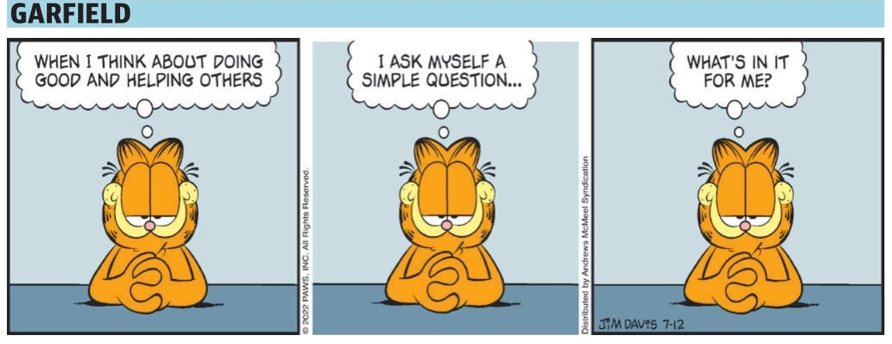
The Courier Mail - Garfield - Comics - The Courier Mail
Monday, Jul 11, 2022

Slide 10
How the Godly Use Wealth – A word for those who are Rich.
Desiring riches is a bad thing. We find our contentment in Christ.
By World standards, most Australians are rich
A Godly person understands True Wealth is found in Christ – Eternal Blessings
Charged not to have an elevated sense of worth/importance
Charged not to depend on the uncertainty of riches
The Godly Enjoyment of Wealth
Some of the poorest in this age are Spiritually wealthy – Eternal life in Christ
The way Christians enjoy what God provides is NOT like the self-indulgence of the ungodly
If God richly provides, the Godly richly share what God has provided
¹⁸ They are to do good, to be rich in good works, to be generous and ready to share,
To do Good.
We personally do good. We don’t outsource serving.
Be Generous
The rich may need to be reminded of this.
If God has given you the capacity to be generous, don’t hold back because you are afraid others won’t do their share.
Be Ready to Share
Sharing our possessions; Sharing ourselves (fellowship, time, community)

Slide 11
¹⁸ They are to do good, to be rich in good works, to be generous and ready to share, ¹⁹ thus storing up treasure for themselves as a good foundation for the future, so that they may take hold of that which is truly life.
Matthew 6:(ESV) ¹⁹ “Do not lay up for yourselves treasures on earth, where moth and rust destroy and where thieves break in and steal, ²⁰ but lay up for yourselves treasures in heaven, where neither moth nor rust destroys and where thieves do not break in and steal. ²¹ For where your treasure is, there your heart will be also.

Slide 12
How the Godly Use Wealth – A word for those who are Rich.
Desiring riches is a bad thing. We find our contentment in Christ.
By World standards, most Australians are rich
A Godly person understands True Wealth is found in Christ – Eternal Blessings
Charged not to have an elevated sense of worth/importance
Charged not to depend on the uncertainty of riches
The Godly Enjoyment of Wealth
Some of the poorest in this age are Spiritually wealthy – Eternal life in Christ
The way Christians enjoy what God provides is NOT like the self-indulgence of the ungodly
If God richly provides, the Godly richly share what God has provided
Do Good.
We personally do good. We don’t outsource serving.
Be Generous
The rich may need to be reminded of this.
If God has given you the capacity to be generous, don’t hold back because you are afraid others won’t do their share.
Be Ready to Share
Sharing our possessions; Sharing ourselves (fellowship, time, community)
As we increase in Godliness, we will enjoy what God enjoys

Slide 13





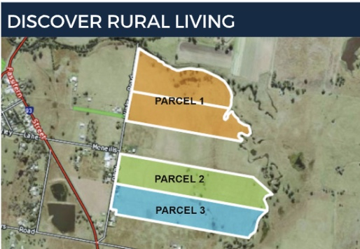

Slide 14
How the Godly Use Wealth – A word for those who are Rich.
The Godly Enjoyment of Wealth
Some of the poorest in this age are Spiritually wealthy – Eternal life in Christ
The way Christians enjoy what God provides is NOT like the self-indulgence of the ungodly
If God richly provides, the Godly richly share what God has provided
Do Good.
We personally do good. We don’t outsource serving.
Be Generous
The rich may need to be reminded of this.
If God has given you the capacity to be generous, don’t hold back because you are afraid others won’t do their share.
Be Ready to Share
Sharing our possessions; Sharing ourselves (fellowship, time, community)
As we increase in Godliness, we will enjoy what God enjoys
Using our wealth in a Godly way (& enjoying it) is Truly Living
²⁰ O Timothy, guard the deposit entrusted to you. Avoid the irreverent babble and contradictions of what is falsely called “knowledge,” ²¹ for by professing it some have swerved from the faith.
Guarding the greatest investment God has in us (The Gospel and Godly Teaching)
Avoid teaching that is the “antithesis” (direct opposite) to what Jesus & Apostles taught

